Slide 1
RAw MaterIals Students Internships in East South East Europe
Acronym: RAISESEE

Slide 2
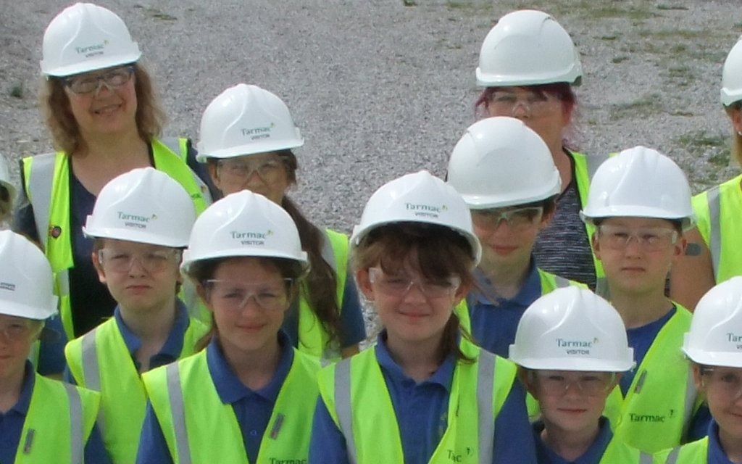
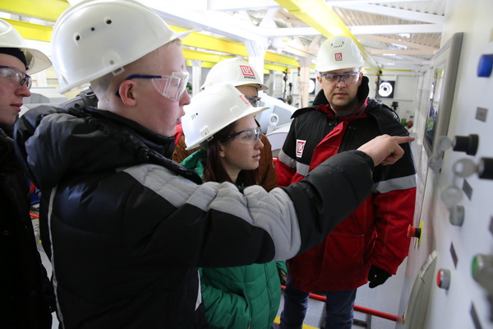
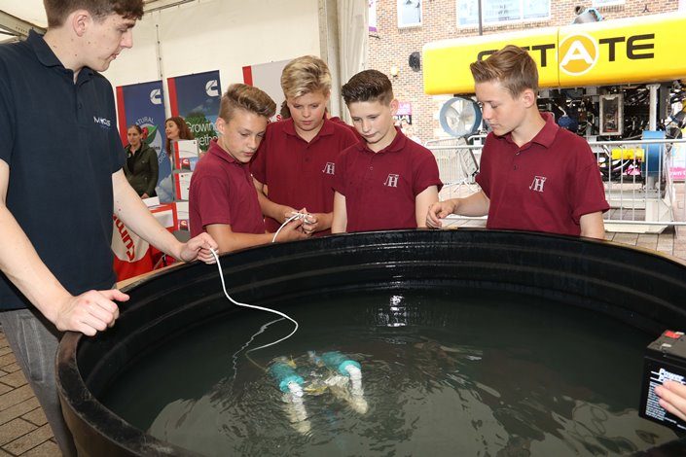
Tarmac’s Tunstead site in Derbyshire
http://komionline.ru/files/material/2017/03/29-03-2017/lu1.jpg

Slide 3
Area
D6 Regional Innovation Scheme (RIS)
Segment
Regional Innovation Schemes (D6)
Duration
2018-07-01 - 2021-12-31
Total budget
90'775 €
Executive Summary
RAISESEE will transfer to ESEE countries the hands-on internships in working environment training model by developing a common program, focused on KIC RM thematic pillars, for secondary schools students. RAISESEE training will support future T-shaped professional at a very early internships of their career and stimulate future universities studies in raw materials related disciplines.

