Slide 1
Dubrovnik International ESEE Mining School DIM ESEE University of Zagreb - Faculty of Mining, Geology and Petroleum Engineering UNIZG-RGNF Assoc. Prof. Sibila Borojević Šoštarić sborosos@rgn.hr duration of project from 2017 - 2021

Slide 2
General description of the DIM ESEE project
DIM ESEE school aim to design a tailor-made and industry-driven school for RM professionals, academics and PhD students, addressing the topics of the primary interest of the RM community
During the four years of project implementation, DIM ESEE will:
contribute to the following topics:
2017 Zero waste management
2018 Deep intelligent mining
2019 Small mining sites
2020 Recycling
create a new multidisciplinary network between project partners and associated industry contributing to building and de-siloing of the overall ESEE RM community
set-up a platform for a constructive dialogue with industrial partners form the ESEE region
brand a DIM ESEE Mining School among industrial partners, academicians and students within the ESEE region and EIT RM

Slide 3
General facts on the DIM ESEE project
Leading partner: University of Zagreb - Faculty of Mining, Geology and Petroleum Engineering, UNIZG-RGNF
Contact person: Assoc. Prof. Sibila Borojević Šoštarić; sborosos@rgn.hr
Duration: 01/2017 – 12/2020
Main thematic area: Regional Innovation Scheme (RIS)
Key market: RM and recycling industry, students, professionals, academicians
Primary KPIs: Products (services) launched on the market (Lifelong Education, SME partners, Successful matches generated)

Slide 5
DIM ESEE outputs
Annual on-line questionnaire – industry-tailoring of the annual DIM ESEE topic content
Supportive industry data base – increasing yearly related to the questionnaire campaign and industry-academia workshops
DIM ESEE annual industry-academia workshop – presentation of the questionnaire results to the industry stakeholders from predefined active mining regions; final tailoring of the annual topic content
2017 Savinja, Slovenia
2018 Hochsteiermark, Austria
2019 Istria, Croatia
2020 Legnica-Glogow Copper District
DIM ESEE programme – annual programme finalized
2017 Zero Waste management
2018 Deep Intelligent mining
2019 Small Mining Sites
2020 Recycling
DIM ESEE on-line programme – annual lectures prepared as on-line course
Multilanguage web page containing wider-society adopted materials with information related to the School and annual DIM topic
Raw materials development cycle with the position of the DIM ESEE education programme
PROSPECTING EXPLORATION EVALUATION
DEVELOPMENT
EXTRACTION
PROCESSING
CLOSURE
RECLAMATION MONITORING
ENVIRONMENTAL ASSSESSMENT
DIM ESSE

Slide 6
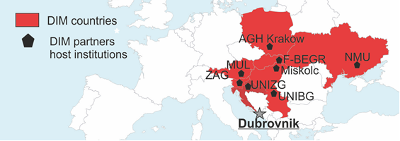
DIM ESEE impacts:
Geographically focused on ESEE Region but also captures the aspect of internationalization because countries like Serbia and Ukraine are involved
Addressing a topics of the primary interest of the RM community
A final users are industrial partners holding a third side of the knowledge triangle
Had already identified eight ESEE active mining regions of high economic importance and associated industrial partners
Attracting minimum 100 industrial partners, identifying a specific industrial needs, creating new partnerships and contributing to overall KIC community building
Educating 160 professionals, academicians and PhD students within 4 years, according to tailor-made topics, potentially increasing a number of new demonstration and pilot plants/prototypes, start-ups or new (urban) mines operating in Europe
Serving as an ideas centre/hub within the ESEE partner network increasing a number of successful matches in industrial symbiosis and potential new KIC projects, being a part of the ESEE Regional Innovation Strategy (RIS)
Communicating with wider society will increase public awareness on environmental aspects of mining and circular economy as one of the main focus of RM community thus increasing public acceptance of overall mining activities

Slide 7
DIM 2016: Lectures within IUC Dubrovnik; lecturer Peter Moser

Slide 8
DIM 2016: Excursion to Sv. Kajo open pit; CEMEX company

Slide 9
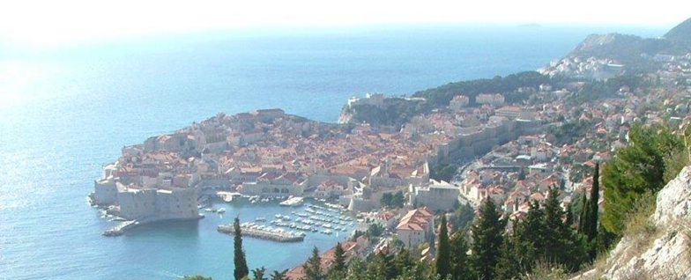
Additional material
Promotional flyer
https://www.rgn.unizg.hr/images/esee/2017/Folder_DIM_V1.pdf
Project web site
https://www.rgn.unizg.hr/en/studies/lifelong-learning/dim-esee-dubrovnik-international-esee-mining-school
Course application
http://www.iuc.hr/programme-application-form.php?progType=course&progId=1061

