Slide 1

HORIZON 2020
Setting up an effective NCP Network
MINISTRY OF EDUCATION AND SCIENCE OF UKRAINE
Stella Shapoval
Deputy Head of Department,
Head of Division of International S&T Cooperation
MINISTRY OF EDUCATION AND
SCIENCE OF UKRAINE
NCP Horizon 2020 National Coordinator

Slide 2
NCPs services:
The work of NCPs is based on:
Minimum standards and Guiding principles for setting up systems of National Contact Points
(NCP systems) under Horizon 2020
Core functions of an NCP:
Informing, awareness raising
Assisting, advising and training
Signposting and cooperation

Slide 3
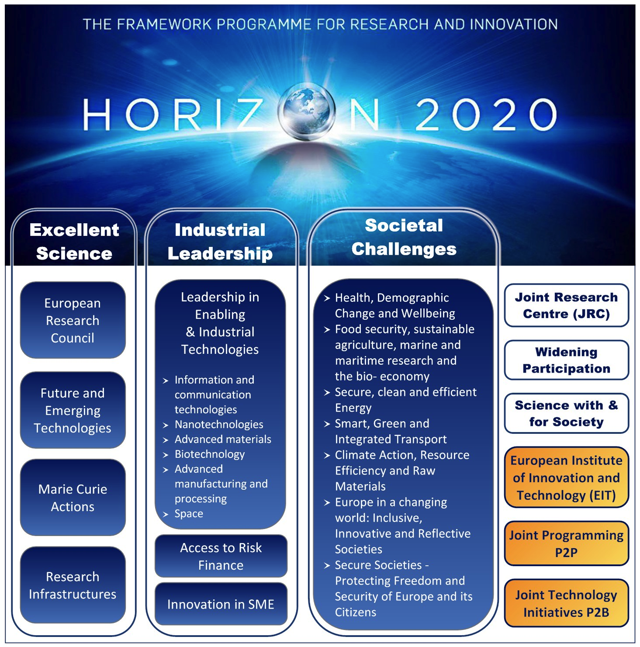
Horizon 2020 NCPs by thematic area

Slide 4
NCP Structure (1)
1. National NCP Coordinator
2. Legal and Financial aspects
3. SMEs*
4. Access to Finance*
5. European Research Council
6. Future and Emerging Technologies
7. Marie Sklodowska-Curie actions on skills, training and career development
8. European Research Infrastructures
9. Information and Communication Technologies (ICT)
10.Nanotechnologies, advanced materials and advanced manufacturing and processing';
11.Space

Slide 5
NCP Structure (2)
12. Health, demographic change and wellbeing
13. Food security, sustainable agriculture, marine and maritime research and the
bio-economy & Biotechnology
14. Secure, clean and efficient energy
15. Smart, green and integrated transport
16. Climate action, resource efficiency and raw materials
17. Inclusive, innovative and reflective societies
18. Security
19.Euratom
20.Joint Research Centre**
21.Spreading excellence and widening participation
22.Science with and for Society

Slide 6
Horizon 2020 Ukrainian NCPs Network
By the order of the MESU as of 13th March 2015 the Ukrainian NCPs Network was established on the base of the Universities and Academic institutions of Ukraine. There are 38 NCPs and 12 RCPs
National NCP coordinator
Ministry of Education and Science of Ukraine
Stella Shapoval
Address: 16 Shevchenko Blvd., 01601, Kyiv, Ukraine
Tel: 380 44 287 82 33 - Fax: 380 44 287 82 50
s_shapoval@mon.gov.ua
Notes:
Мережу НКП в Україні створено за наказом МОНУ на базі освітніх та академічних установ. Ваш Національний контактний пункт (НКП) також може допомогти вам знайти відповідний конкурс за вашим профілем. Перелік НКП розміщений у розділі «Підтримка» на порталі учасників програми «Горизонт-2020», на Національномі порталі Програми Горизонт 2020

Slide 7
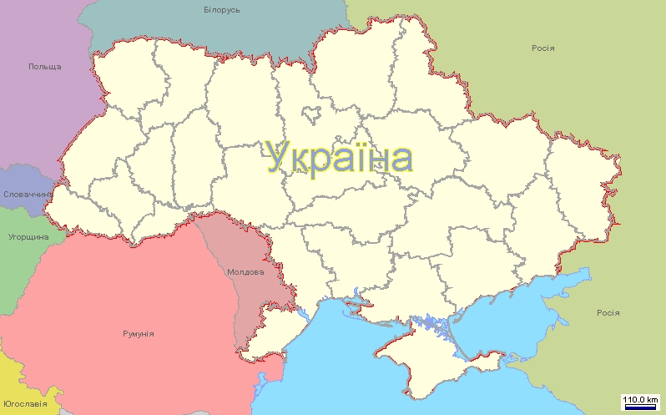
Ukrainian NCPs by regions
Kyiv
Lviv
Kharkiv
Vinnytsya
Poltava
Ivano-Frankivsk
Uzhgorod
Dnipro
Odesa

Slide 8
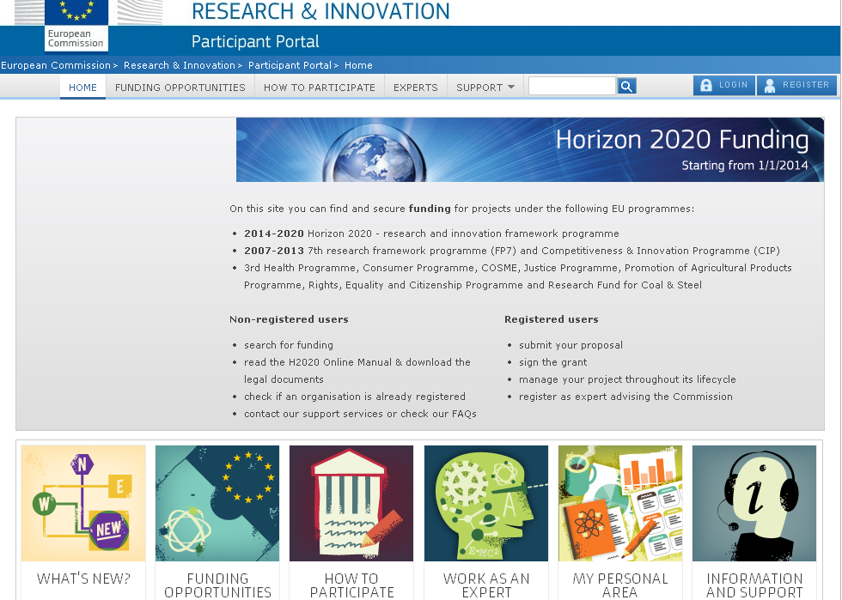
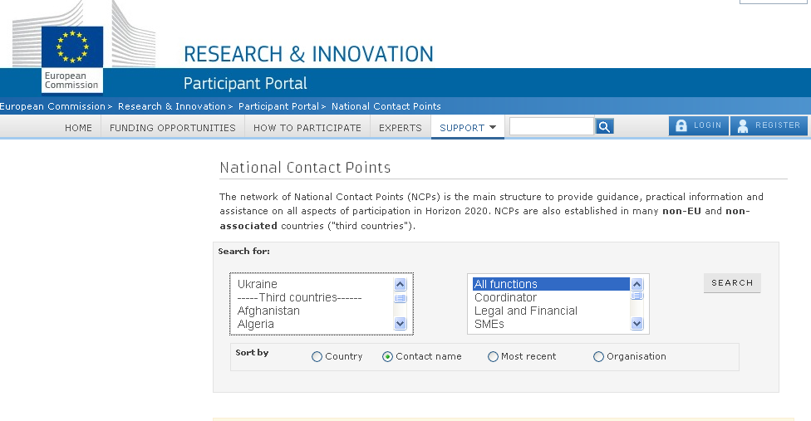
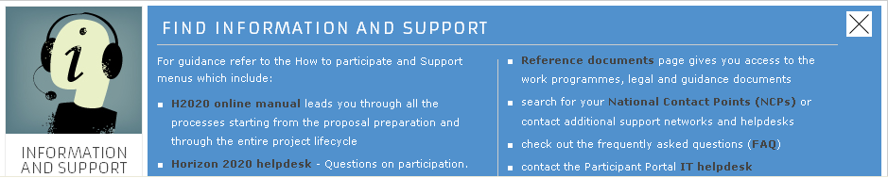
H2020 Participant Portal. H2020 NCPs Information http://ec.europa.eu/research/participants/portal/desktop/en/home.html http://ec.europa.eu/research/participants/portal/desktop/en/support/national_contact_points.html

Slide 9
A well-designed portfolio of NCPs services
Excellent professional qualification of NCP staff
Developing the client base - capacity building
Creating awareness on EU R&I programmes
Disseminating general and specific information
Assisting in partner search and in preparing proposals/pre-review
Providing strategic advice to R&I organisations
Training of clients on H2020 issues
Monitoring the participation in Horizon 2020
Networking with NCPs in other countries
Signposting to other EU network services
Signposting to other business support network services (e.g. EEN, EIB etc.)
Signposting to national funding services and programmes
Strong strategic partners
Acceptance & recognition by scientific and business communities and organisations

Slide 10
Synergy of the National, EC, EU MS support
- Support of the NCPs activity is part of the H2020 implementation Plan
- MESU provides financing support
- Participation at the EC Information Events
- Conference-training for EaP NCPs
- NCPs Awareness Raising Campaign implemented within the INCONet EaP Project
- Training, Study visits of the Ukrainian NCPs in Estonia
- Study Visits (Energy NCP, Health NCP, Environment NCP) supported by INCONet EaP
- Access to the NCPs networking projects
- It is planning a rage of NCPs capacity building actions within RI-LINKS2UA and INCONet EaP+ projects activity
- Building the Ukraine-MS/AC NCPs strong networking

Slide 11
Recommendations to the NCPs
Define a common self-concept and clear profile
Raise awareness and improve external communications
Intensify consultation and advisory activities (proposal preparation)
Central coordination of NCP-system
Assessment and improvement of project management structures
Coordinated actions of NCPs and other service providers, esp. to promote the participation of SMEs
Provide a well hosted web site with all relevant documents, up to date information
Prepare examples, best practice (successful proposals, filled in documents etc.)
Specialise in relevant programmes, focus on certain aspects of H2020
Build a network with experts, colleagues
Be prepared to fulfil special needs of consultancy – focus on target groups, offer tailor made information and events
Consider background, premises and experience of the scientists („customer orientation“)

Slide 12
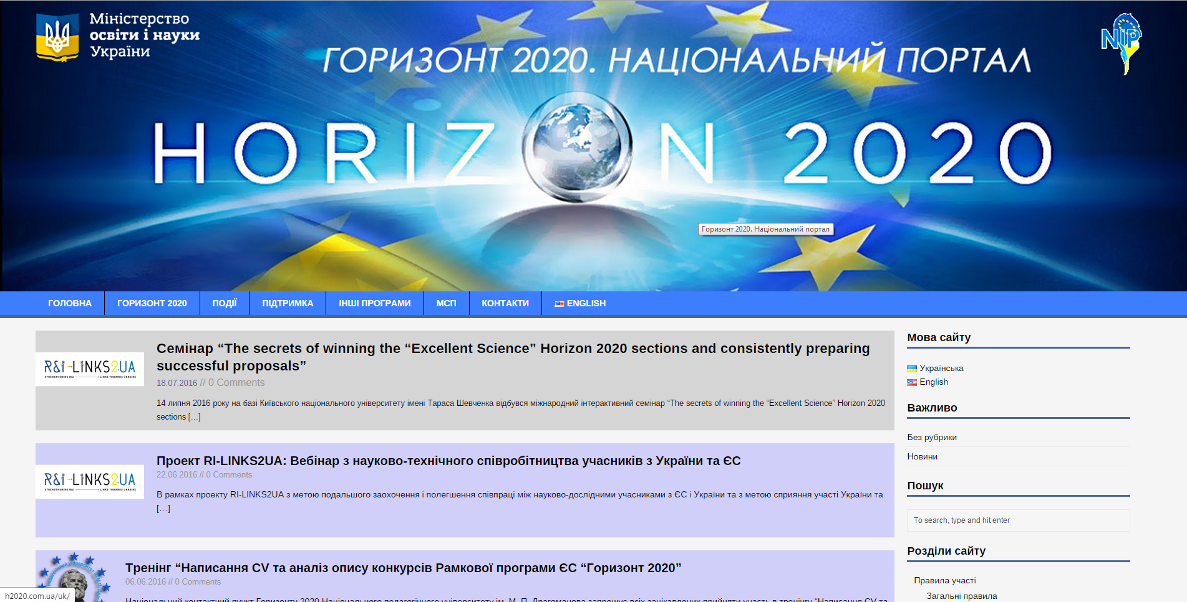
National portal Horizon 2020 http://h2020.com.ua/

Slide 13
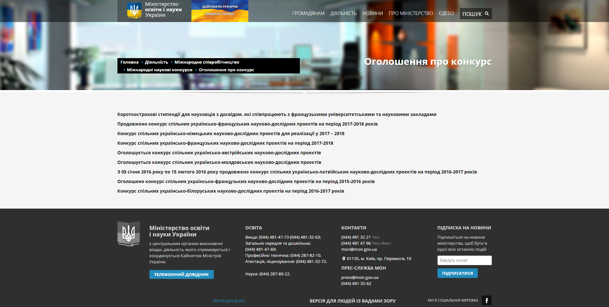
International bilateral scientific calls of MESU

Slide 14
Thank you for your attention!
s_shapoval@mon.gov.ua

